Slide 1
Nervous Activity Analyzer Biological Signals by Jonas, Robel, Maria
3-June-2014

Slide 2
INPUTS & OUTPUTS
Acquisition Parameters
Raw Data
Computed Signal
Processing Parameters

Slide 3
WORKFLOW
Load Raw Data
Process Wave
Filter
Compute STD, AVG, CC
Plot and Display
Enter Parameters

Slide 4
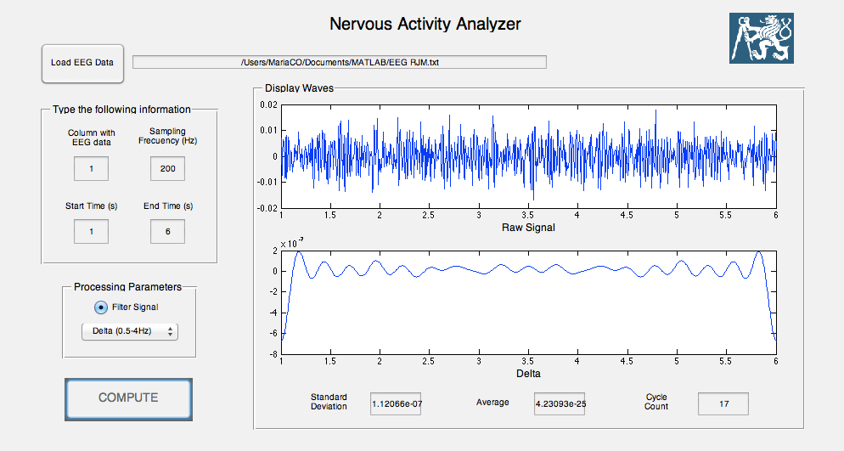
Graphical User Interface - GUI

Slide 5
Graphical User Interface - GUI

Slide 6
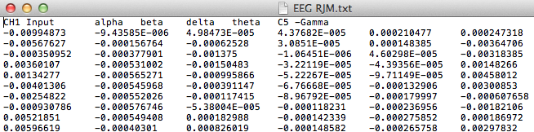
Load Raw Data
[filename,filepath]=uigetfile({'*.*','All Files'},'Select EEG File');
fullpathname=strcat(filepath, filename);
set(handles.text_path, 'String', fullpathname)
handles.rawdata1=load(fullpathname)

Slide 7
Enter Parameters
handles.column1 = str2double(get(hObject,'String'));
handles.fs1 = str2double(get(hObject,'String'));
handles.t11 = str2double(get(hObject,'String'));
handles.t21 = str2double(get(hObject,'String'));
handles.Filter1 = (get(hObject,'Value'));
handles.Wave1 = (get(hObject,'Value'));

Slide 8
Filter
Filtering the EEG data by using FIR filters.
It was filtered for the following:
50Hz Powerline interference with a band stop filter
0.5Hz Highpass and 90Hz Low pass filter
FIR was chosen over IIR because:
FIR filters are inherently stable
FIR filters have a linear phase
FIR are robust to quantization
%FIR FILTERS
a = fir1(100,[f1n f2n], 'stop'); %50hz notch filter
y = filter(a,1,data1);
b = fir1(100,[f1l f2l], 'low'); %90Hz lowpass filter
x0 = filter(b,1,y);
c = fir1(100,[f1h f2h], 'high'); %0.5Hz highpass filter
x = filter(c,1,x0);

Slide 9
Specify values for Wn
fir1 implements the classical method of windowed linear-phase FIR digital filter design.
b = fir1(n,Wn,'ftype')
n specifies the order of the filter
Wn = [f1 f2] is a two element vector between 0 and 1 where 1 corresponds on the Nyquist Frequency
They were calculated using the following code
k = 0.003;
f1n = (50/(fs/2)) - k;
f2n = (50/(fs/2)) + k;
f1l = (90/(fs/2)) - k;
f2l = (90/(fs/2)) + k;
f1h = (0.5/(fs/2)) - k;
f2h = (0.5/(fs/2)) + k;

Slide 10
Process Wave
Extraction of Delta, Theta, Alfa, Beta or Gamma wave using FFT & IFFT functions.
1. transform given signal to frequency domain using FFT
2. extract desired wave (frequency band) into blank vector using switch, based on user’s selection
switch wave
case 1
curve='Delta'
B(round(m/2-0.5*m/fs):round(m/2-4*m/fs))=fur(round(m/2-0.5*m/fs):round(m/2-4*m/fs)) B(round(m/2+0.5*m/fs):round(m/2+4*m/fs))=fur(round(m/2+0.5*m/fs):round(m/2+4*m/fs))
3. transform back into time domain using IFFT
4. create time vector based on sampling frequency and duration
t=t1:1/fs:t2
5. plot against the time vector

Slide 11
Compute STD, AVG, CC
Standard deviation
Sdev=std(z)
Average
Avg=mean(z)
Cycle count
Cc=0
tr=0
for F = 2:m
E=F-1;
if tr==1
if z(F)<z(E)
Cc=Cc+1
tr=-1
end
end
if z(F)<z(E)
tr=-1
else
tr=1
end
end

Slide 12
Plot and Display
plot(handles.plot1,t,data1)
plot(handles.plot2,t,z)
set(handles.Sel_wave,'String',curve)
set(handles.STD1, 'String', STD)
set(handles.AVG1, 'String', AVG)
set(handles.CC1, 'String', CC)

